Slide 1

Tutorial Questions （Week 9）
Juntao Zhang(张峻滔), TA
Southern University of Science and Technology
Email: 12332164@mail.sustech.edu.cn

Slide 2
Outline
Review
Basic Problems with Answers 4.10 4.16
Basic Problems 4.26 4.30
Q&A

Slide 3
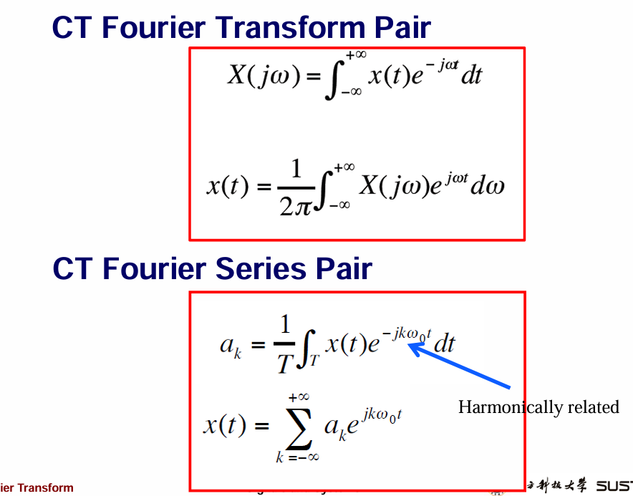


Slide 4
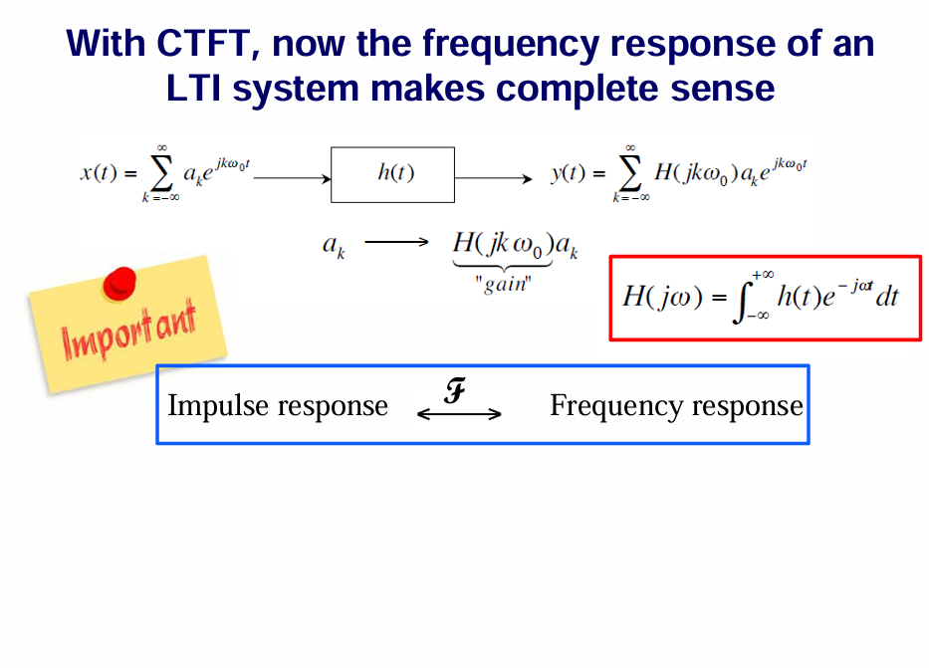

Slide 5
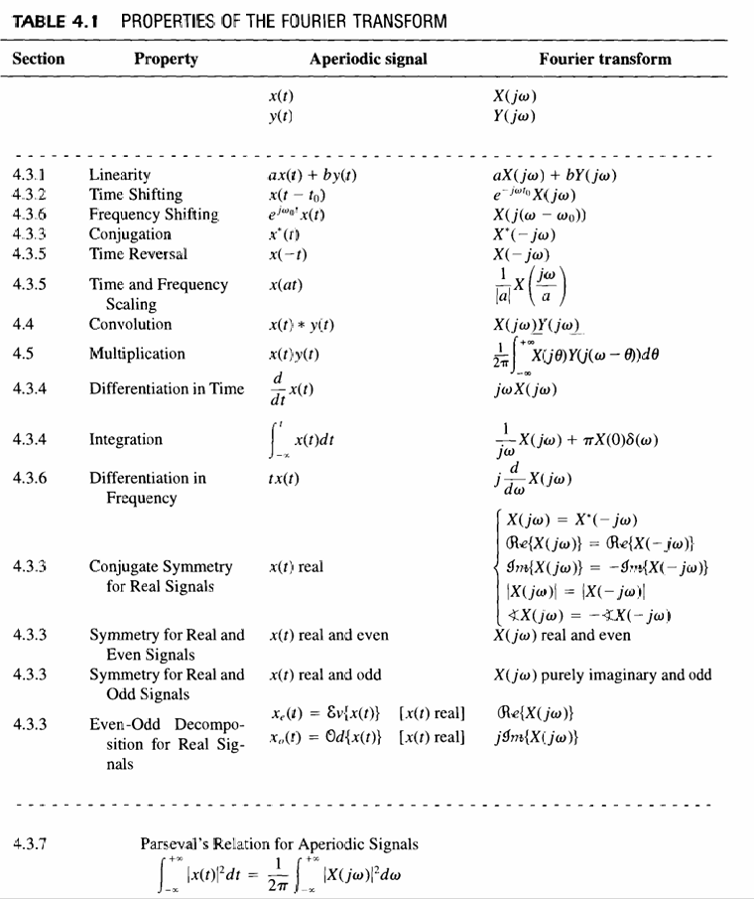
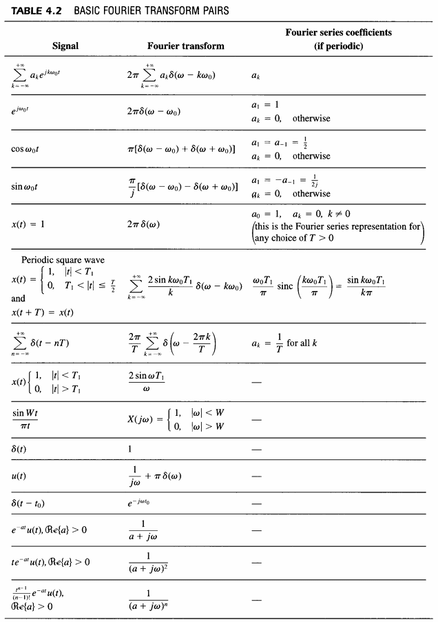

Slide 6
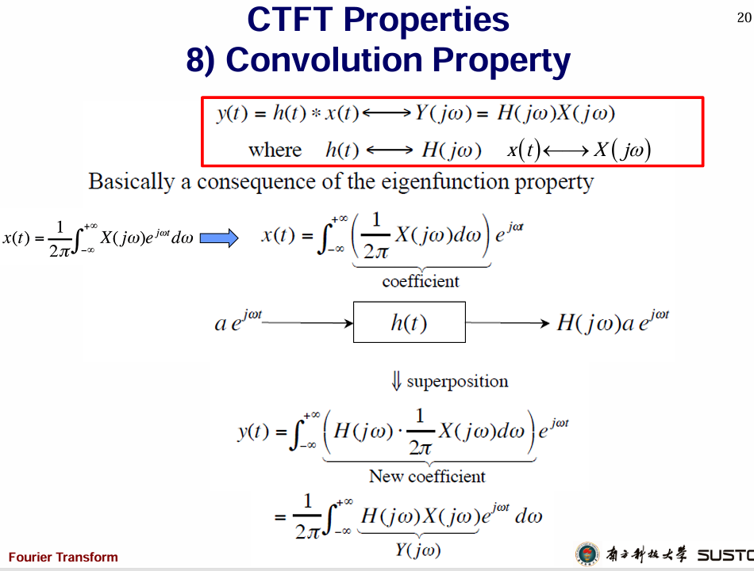


Slide 7
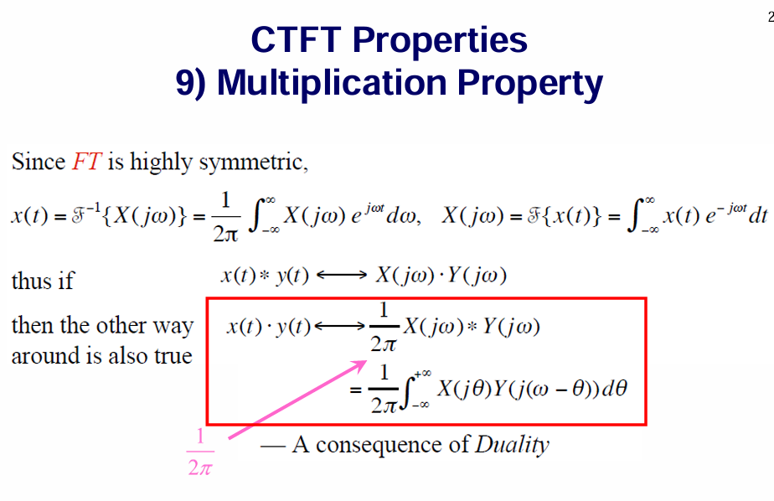

Slide 8
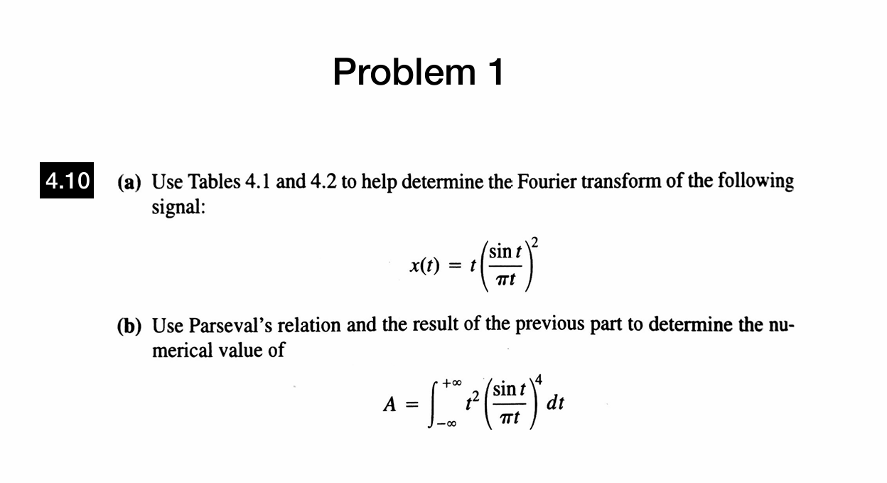

Slide 9
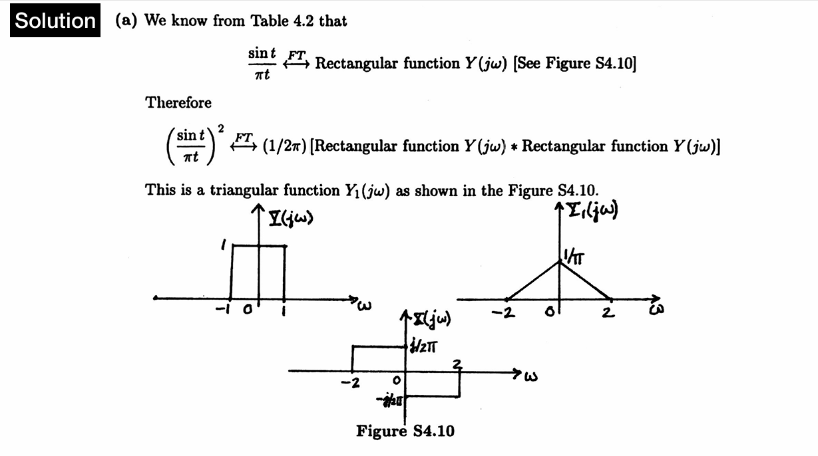
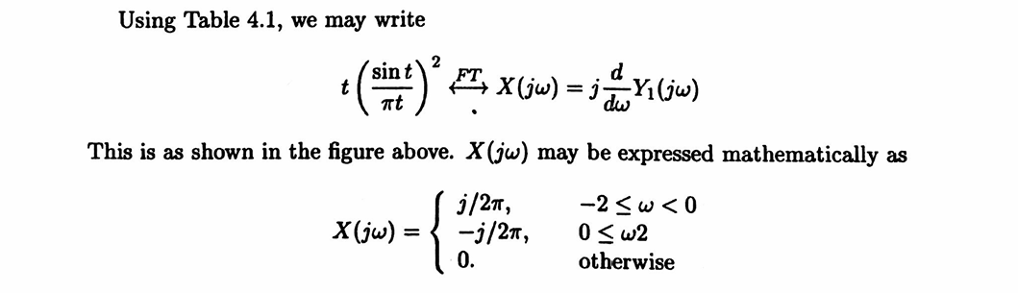

Slide 10




Slide 11
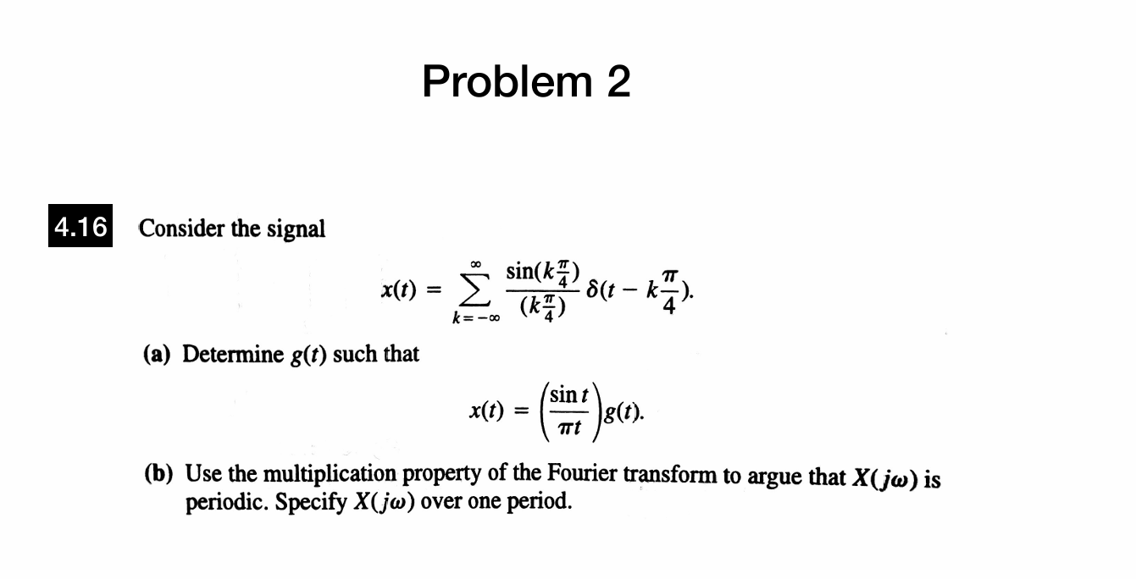

Slide 12
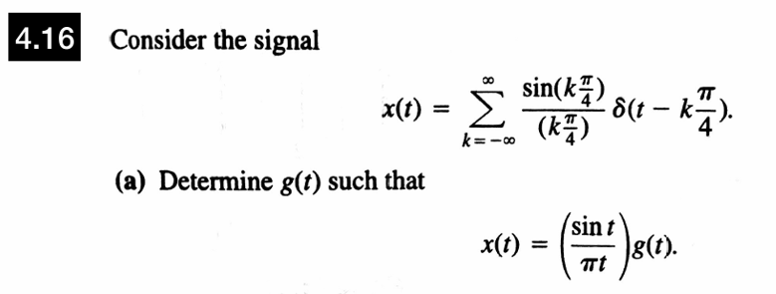


Slide 13



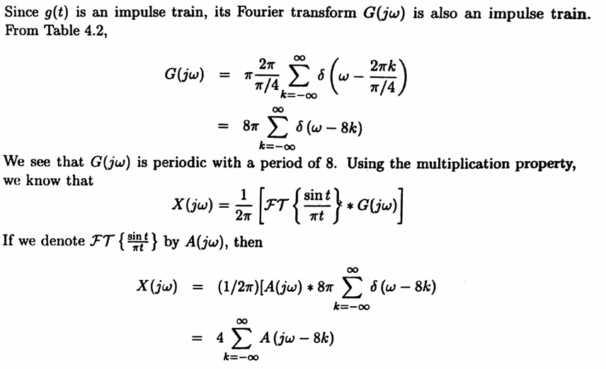

Slide 14
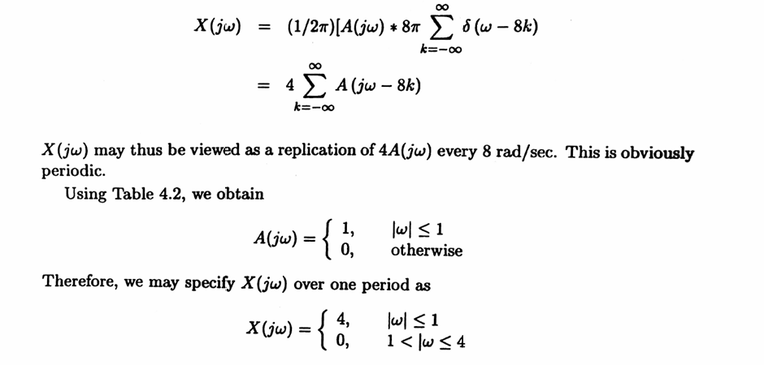

Slide 15
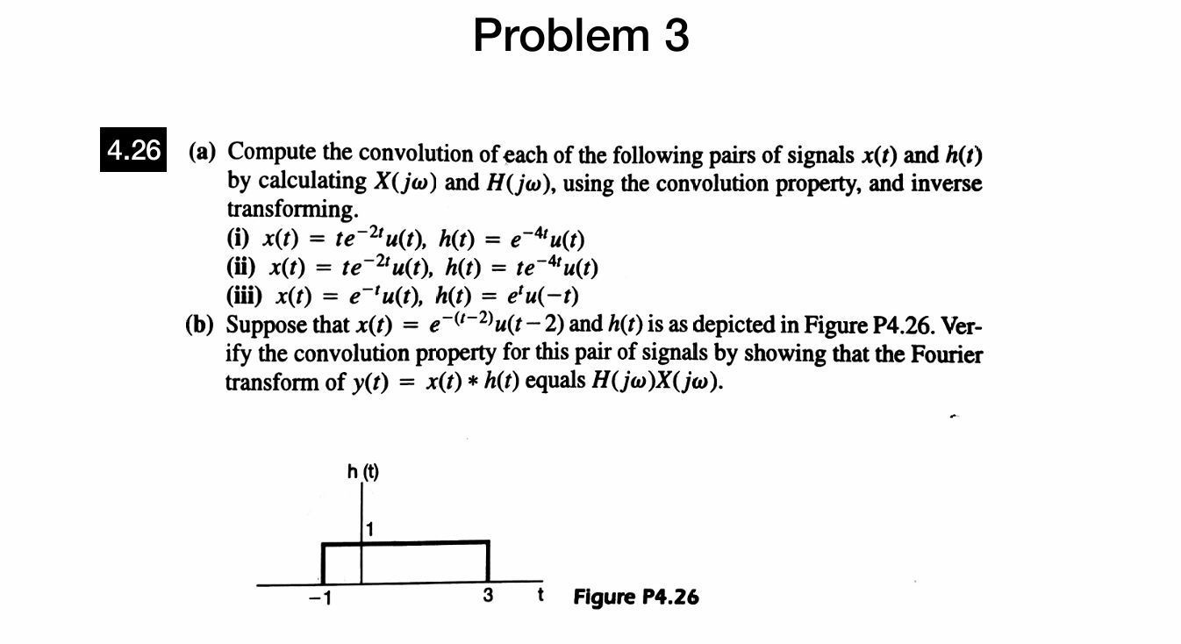


Slide 16

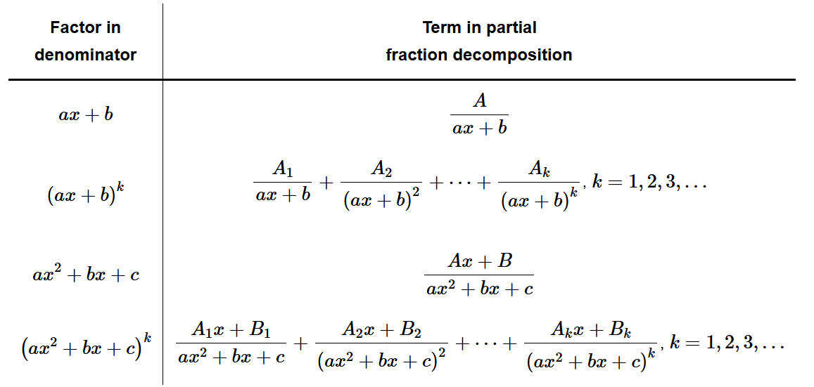
Partial Fractions

Slide 17
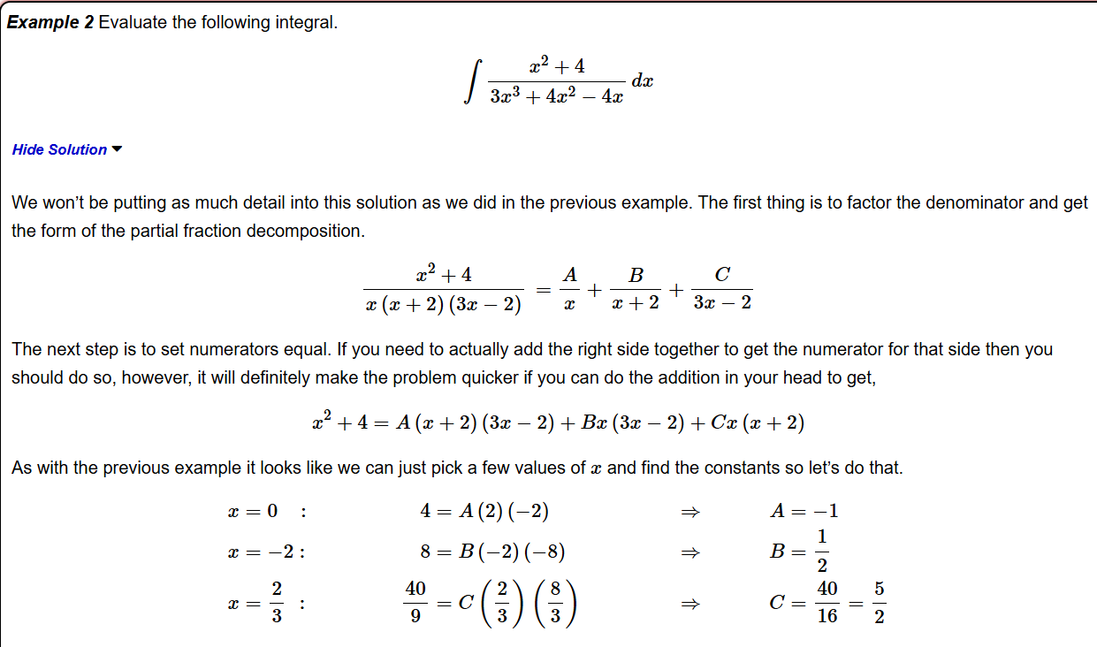

Slide 18
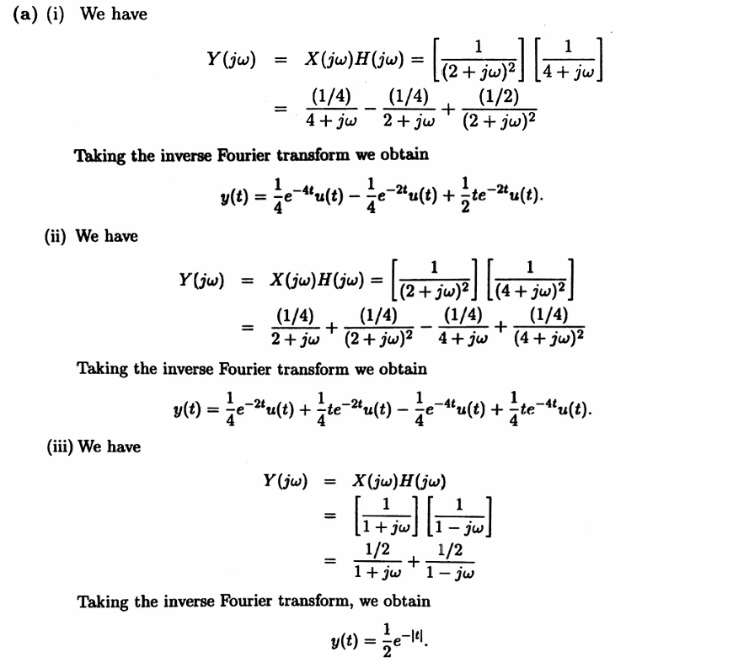


Slide 19
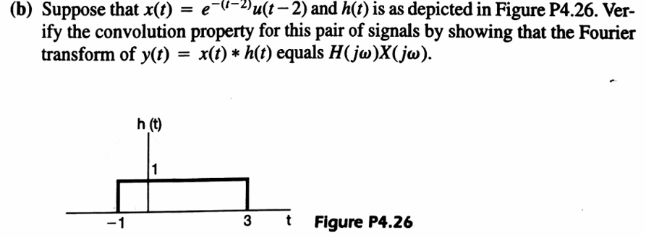
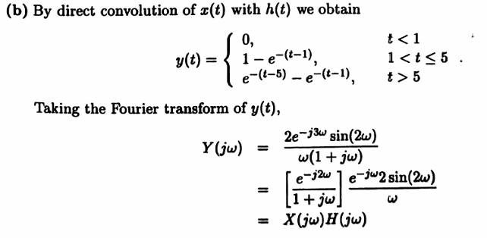

Slide 20
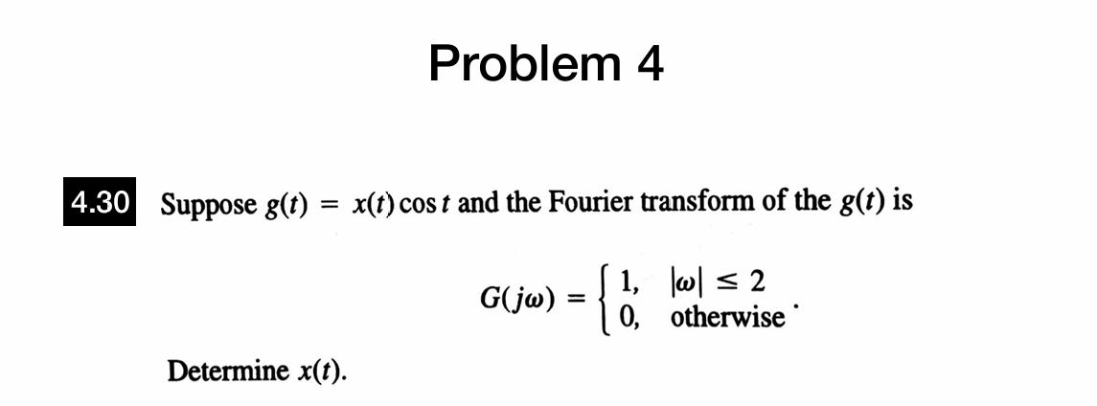

Slide 21
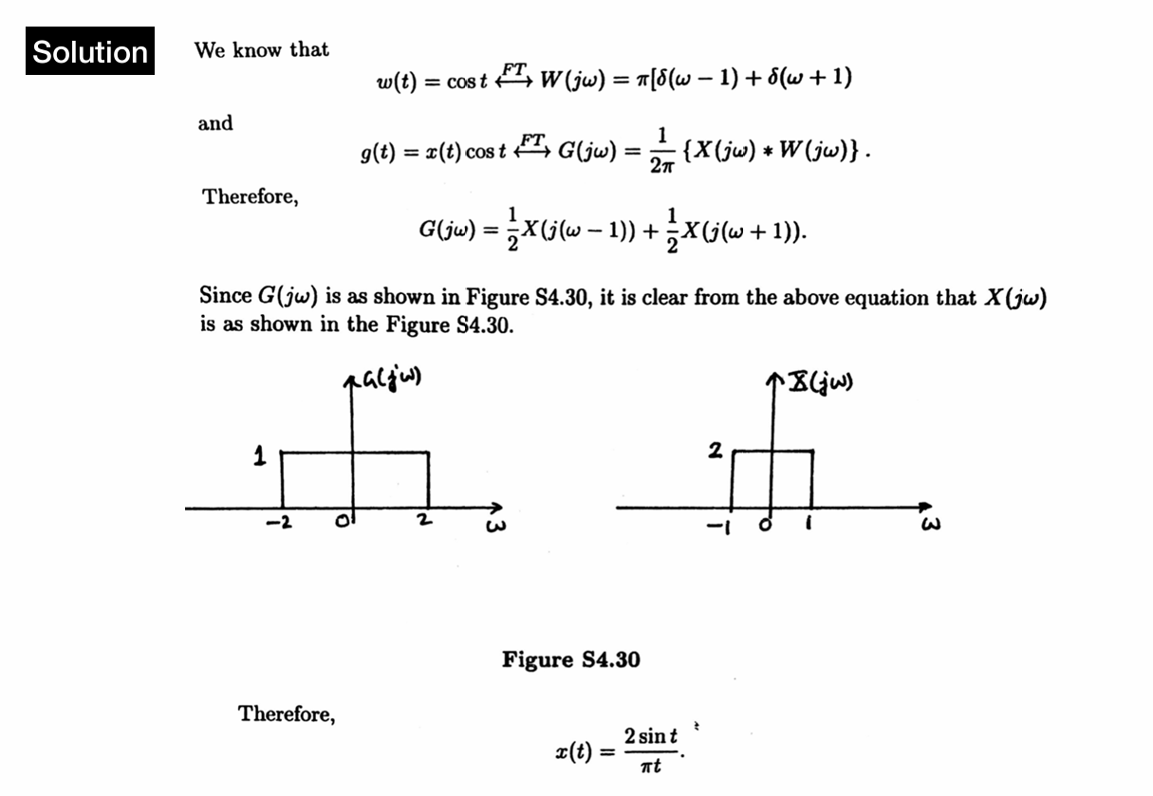

Slide 22
Thanks for Your Attendance
Q&A
Juntao Zhang(张峻滔), TA
Southern University of Science and Technology
Email: 12332164@mail.sustech.edu.cn

